Slide 1

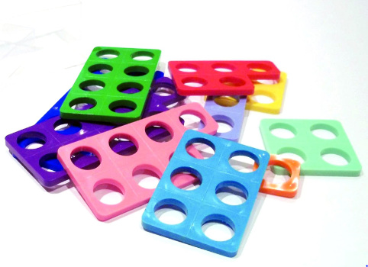
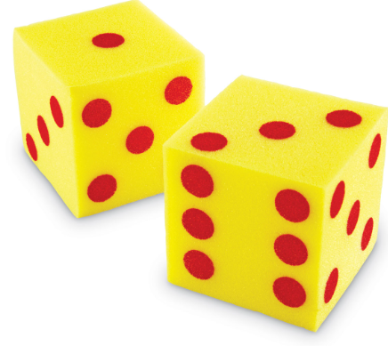
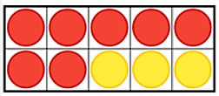
Supporting your child at home in mathematics

Slide 2
Early learning goals (ELGs)
Number
Have a deep understanding of number to 10, including the composition of each number
Subitise (recognise quantities without counting) up to five
Automatically recall (without reference to rhymes, counting or other aids) number bonds up to five (including subtraction facts) and some number bonds to 10, including double facts
Numerical patterns
Verbally count beyond 20, recognising the pattern of the counting system
Compare quantities up to 10 in different contexts, recognising when one quantity is greater than, less than or the same as the other quantity
Explore and represent patterns within numbers up to 10, including evens and odds, double facts and how quantities can be distributed equally

Slide 3

Counting principles
1:1 principle- the need to count each object once (without skimming or flurrying)
Stable order principle- saying the number names in the correct order and understanding that this will not change (counting songs and rhymes help this)
Order irrelevance principle- the understanding that the order objects are counted is not important
Cardinal principle- the final number counted tells the counter how many objects are in the group (conservation number- this does not change even if the objects are moved around)
Abstraction principle- everything can be counted including actions and sounds

Slide 4
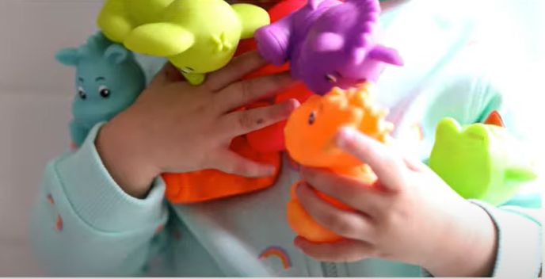
Number sense
Critical to a deep understanding of number
Most children can count to ten sequentially
They need to associate numbers with quantity e.g. they know they are four, but do they know they are four years old?
Expose children to lots of opportunities to handle, sort, compare and count real objects
Handling quantities helps children to understand their value e.g. they may hold two objects in one hand, but as the quantity of objects increases they will need two hands, so they feel how the quantity increases
Understanding 10- composition, subitising and patterns in number

Slide 5

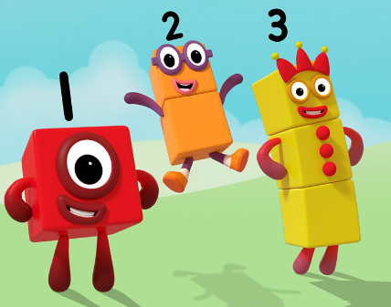
Our maths lessons
White Rose Maths
Whole class carpet session
Split into two groups for a more focused, practical activity
Mastering Number
Fast maths
Whole class session
Recaps prior knowledge
Uses number blocks as visual aids

Slide 6
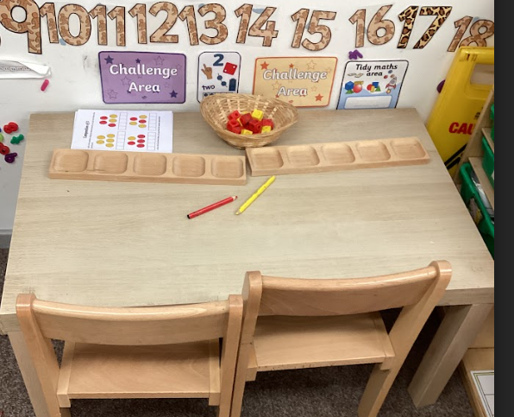
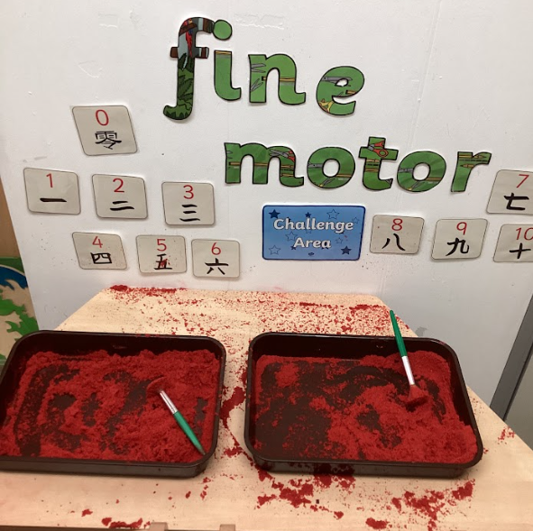

Continuous provision
Maths area with resources- giant dice, math link cubes, five frames, numicon, numerals
Maths table- updated weekly with a maths challenge based on what we are learning
Using maths in the environment e.g. toy shop with money, Chinese new year fine motor, chalk numbers, repeating patterns with natural objects

Slide 7

Do you have any questions?

