Slide 1
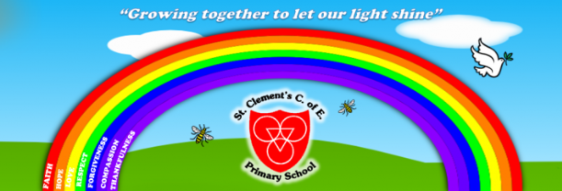
CHILDREN’S DAY

Slide 2
What is Children’s day?
Children’s day is celebrated each year on the birth anniversary of India’s first Prime Minister Jawaharla Nehru , which is on November 14 .
Children’s day is celebrated as a tribute to Nehru. Nehru ,fondly called ‘Chacha Nehru ‘. He was known for his affection and care towards children.

Slide 3
Link to values
Children’s day links to our Christian values of respect and thankfulness. We show respect to each other and we are thankful that we are all unique.

Slide 4

Respect and Thankfulness
What does thankfulness mean?

Slide 5
Thankfulness means…
To be grateful for the good things in your life .
To show thankfulness you could say thank you to God who gave it to you.
You can also do something kind to make other people thankful.

Slide 6
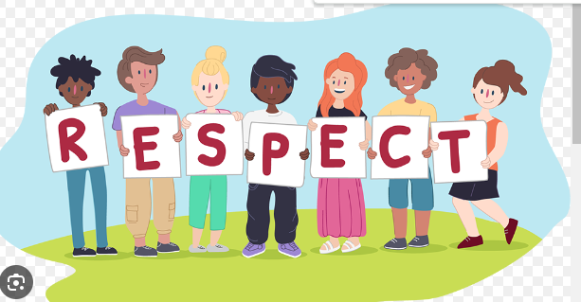
What is respect?

Slide 7
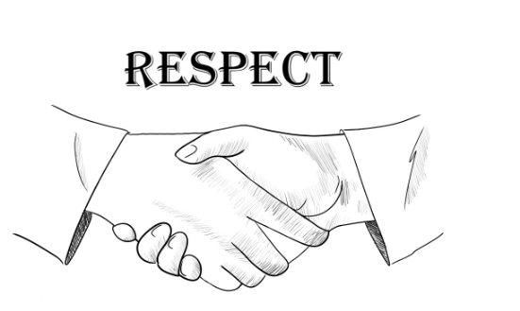
What does respect mean…
Think about how respect can make people happy.
Think about how it makes you feel when you are not respected

Slide 8

RESPECT
Respect links to kindness and if you show respect then you are being compassionate .

Slide 9
Prayer
Emma and Susie

