Slide 1
lent

Slide 2
Why is lent important?

Slide 3
What is lent ?

Slide 4
Lent is the six week period leading up to Easter. It’s one of the most important times of year for many Christians around the world, particularly those within the Anglican, Catholic and Orthodox traditions, held at a similar level of importance to Advent – the build up to Christmas.
While Advent is a celebration and a time of great anticipation, Lent is more frequently seen as a time of solemn observance and preparation for the celebration of the death and resurrection of Jesus at Easter. From its start on Ash Wednesday until its conclusion on Easter Sunday, Lent has been a traditional time for fasting or giving something up or abstinence. Just as we carefully prepare for events in our personal lives, as a wedding, or birthday; a commencement Lent invites us to make our minds and hearts ready for remembering Jesus’ life, death and body resurrection.

Slide 5
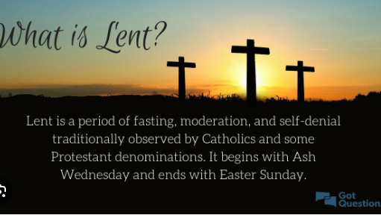
How dose lent connect to our Christian values

Slide 6
Matthew 6:16-18 When you fast, do not look somber as the hypocrites do, for they disfigure their faces to show others they are fasting. Truly I tell you, they have received their reward in full. But when you fast, put oil on your head and wash your face, so that it will not be obvious to others that you are fasting, but only to your Father, who is unseen; and your Father, who sees what is done in secret, will reward you.

Slide 7
What do you think about this bible verse

Slide 8
lent is the season of the church year that follows the Epiphany Season. It is a time we set aside each year to remember the love of God that is poured out through Christ Jesus on the cross in His death; and His defeat of death, sin and Satan in Christ's death and resurrection that brings Eternal Life to you

Slide 9
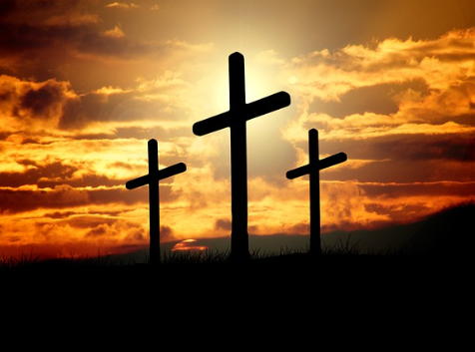
Here`s a task

Slide 10
Name some of the things you can do for lent?

Slide 11
Give up a favorite toy or game.
Fast from social media for a day.
Give up a favorite snack.
Drink only water at school.
Give up a favorite chair at home or seat at school.
Go without headphones/air pods for a day.
Play your favorite game, focusing on helping others instead of winning.

Slide 12
Hands together

Slide 13
Almighty and ever living God,
you invite us deeper into your world, your people, your Lent.
May this time be one of outward focus;
seeking you in those we often ignore.
Help us live a Lent focused on freedom, generosity, and encounter.
Give us hearts hungry to serve you
and those who need what we have to give.

